Slide 1
Alston Ridge Literacy Night
First Grade Team
September 26, 2019

Slide 2
How Students Learn To Read:
How Students Learn To Read
Naming Letters
Letter Sounds
Blending Sounds
Decoding Words
Reading Sentences
Once students are able to decode words and read sentences fluently, we emphasize comprehension.

Slide 3
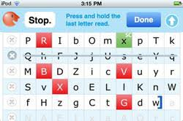
LNF (Letter Name Fluency)

Slide 4
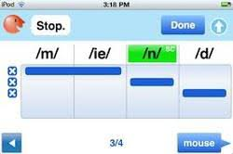
PSF (Phoneme Segmentation Fluency)

Slide 5
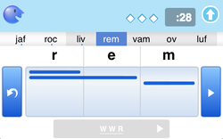
NWF (Nonsense Word Fluency)

Slide 6
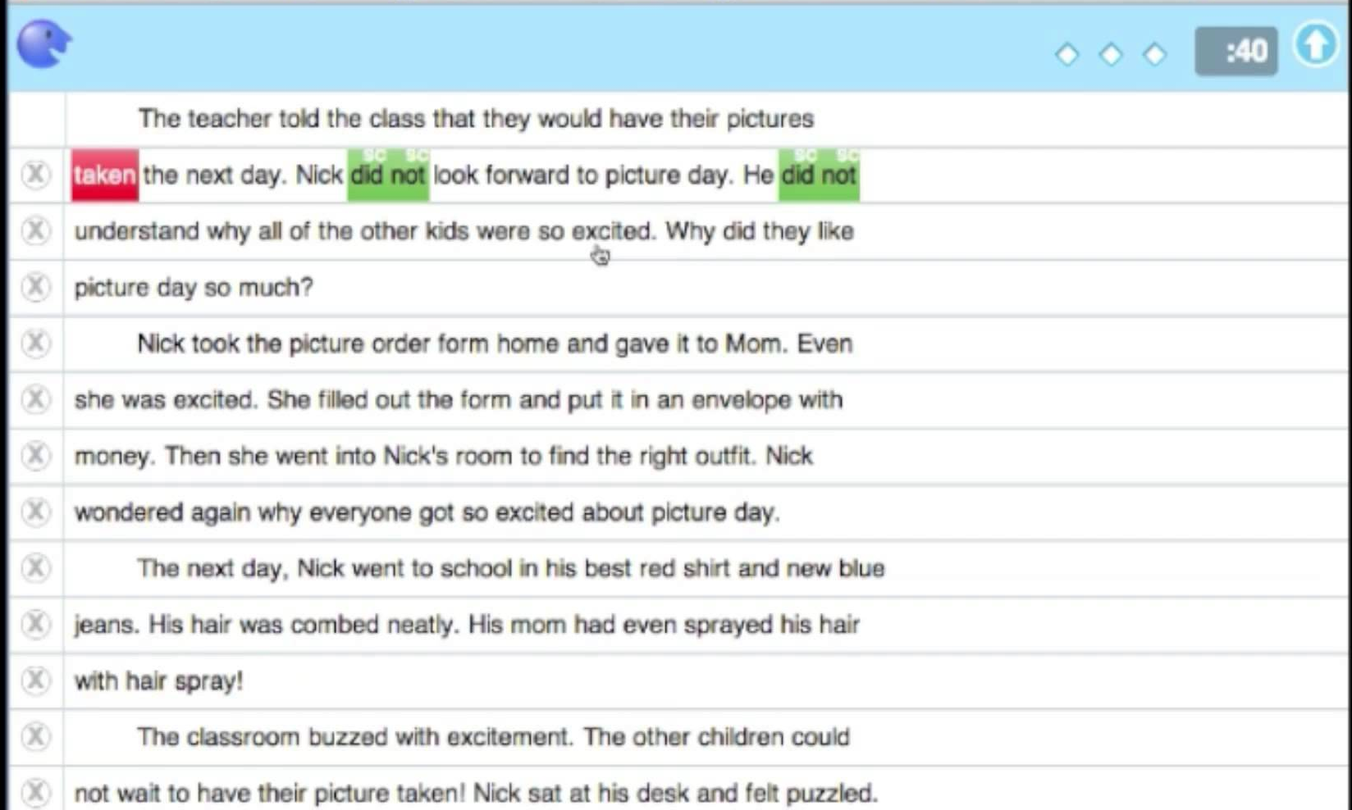
DORF (DIBELS Oral Reading Fluency)

Slide 7
TRC (Text Reading Comprehension)

Slide 8
Engaging Your Child in Reading
Make reading about the relationship with your child and not about the book.
One of the best ways to engage your child in reading is to ensure that they’re reading books of interest to them.
It is ok for students to read about the same topic for an extended period of time. The main focus is to have them excited and engaged in reading.
If it’s something that’s an interest of theirs they’re more likely to read and be engaged in what they’re reading.

Slide 9
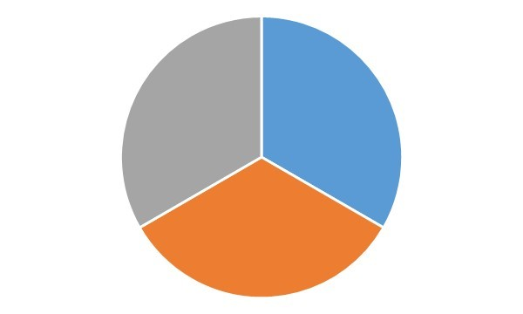
A Healthy Reading Diet
Vacation
Challenge
Vacation books: These are books that may be easy for your child.
Challenge books: These are books that are difficult for your child,
Just Right books: These are books that are on your child’s independent reading level.
It is important that your child has a “balanced reading diet”.
Just Right

Slide 10
Fiction
Non-fiction
Made up or imaginary
Tells a story
Start at the beginning
and read in order
Plot
(beginning, middle, end, character, setting, problem, solution, moral)
Characters
Setting
Problem
Solution
illustrations
Provides facts
or information
Can start anywhere
Text Features (photographs, captions, bold words, glossary, headings, index, diagrams, maps)
Title
Illustrations
Table of contents

Slide 11
Helping Your Child with Comprehension
Rereading is a great strategy for supporting comprehension.
Stop and discuss the book throughout. Ask concrete/literal questions that can be found in the text, as well as, creative and inferencing types of questions that require the student to think deeply about text.
Encourage your child to find evidence within the text. Can you find a sentence that proves your character is feeling happy?
Making connections with the text. Does this remind you of something you have done? Felt?
Notes:
Tell parents to look in folder

Slide 12
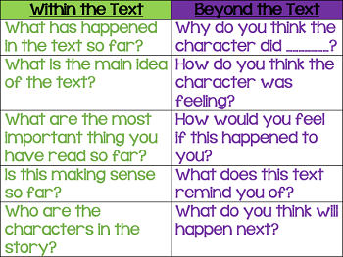
Questions to
Ask During Reading:

Slide 13
A Little About Rereading….
Reading a book more than once supports students fluency (their reading rate and expression) and their comprehension.
The first time a student reads a text, they are often spending time sounding out words. This is great practice and an important part of reading progress.
Subsequent readings allow students to focus more on fluency, expression, and comprehension. They are less focused on sounding out words and are able to think about the story. Perhaps most importantly, rereading builds reading confidence for your child!

Slide 14
Online Literature Resources (See handout)
1. Raz Kids 6. Starfall
2. Brainpop 7. Just Books Read Aloud
3. Big Universe 8. Reading Resources
4. PebbleGo 9. Storyline Online
5. ABCYA! 10. National Geographic Kids

Slide 15
Questions?

