Slide 1
Welcome to Curriculum Night
Alston Ridge Elementary School
Kimberly Mallard
kmallard@wcpss.net
Website: http://msmallardsclass.weebly.com
Teacher Assistant: Karla Welch

Slide 2
Daily Schedule
8:45 Arrival
9:15 – 10:15 Literacy Centers
10:15 – 10:45 Letterland
10:45 – 11:10 Reading Comprehension
11:10 – 11:40 Lunch
11:40 – 12:20 Writing
12:20 – 1:15 Math
1:15 – 1:45 Recess
1:45 – 2:10 GATOR Time (remediation and enrichment)
2:10 – 2:55 Science/Social Studies
2:55 – 3:35 Specials
3:35 Dismissal

Slide 3
Grading Policies
Complete policies on all topics are available on my website.
Many of our skills are ongoing in both literacy and math. Do not panic if your child gets a 2 on a progress report or report card, especially first quarter.

Slide 4
First Grade Goals
Work Habits and Social Skills
Communicate effectively with others—including responding to someone else in conversation
Show strong collaborative skills
Think critically, be able to form opinions and support those opinions
Persevere, think in new ways
Self-direct learning and activities
Show responsibility for themselves and their belongings
Engage in conflict resolution and social problem solving

Slide 5
Conflict Resolution
A big part of first grade is learning how to develop communication, self advocacy and conflict resolution skills.
Typically developing first graders will engage in low intensity conflicts, especially during the course of non-structured play such as recess, the lunch room and on the bus. Our goal is to help them become independent problem solvers, whether that means walking away, speaking up for themselves or a peer or seeking help from an adult when necessary.
With that being said, we encourage students to advocate for themselves unless they genuinely feel physically or emotionally unsafe.

Slide 6
What is bullying?
When someone says or does something unintentionally hurtful and they do it once…
that’s RUDE.
When someone says or does something intentionally hurtful and they do it once….
that’s MEAN.
When someone says or does something intentionally hurtful and they keep doing it even when you tell them to stop or show them that you’re upset…
that’s BULLYING.

Slide 7
First Grade Goals
Academics
Read fluently with in-depth comprehension of texts
Communicate with others through effective dialogue
Write with clarity for a variety of purposes
Demonstrate fluency in math and development of in-depth number sense and place value understanding
Demonstrate deeper thinking about science and social studies concepts
Persevere through problem solving and inquiry

Slide 8
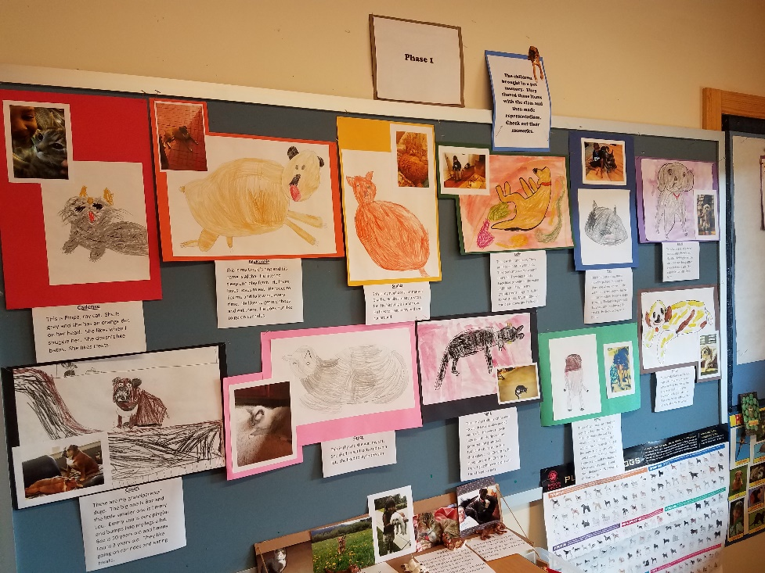
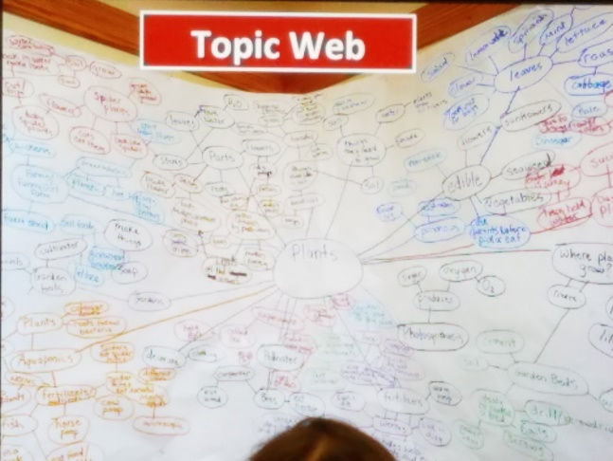
Project Approach
Phase 1: What do we already know?
Sharing stories
Topic web
Ask questions/wondering

Slide 9
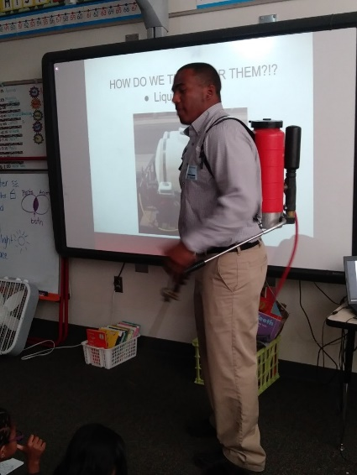
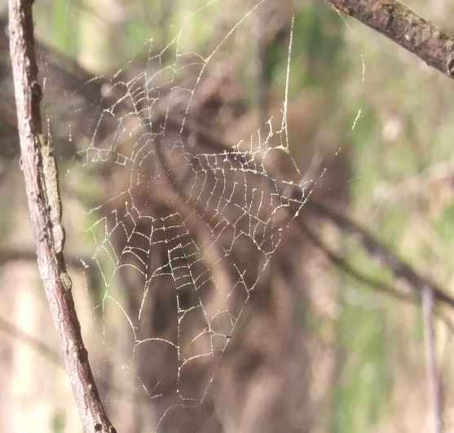
Project Approach
Phase 2: The investigation begins!
Field experiences and guest experts
Reflect on learning creatively
Updating topic web
Ask new questions and narrow areas of interest
Select a topic for inquiry and start investigating
Dramatic play or investigation stations

Slide 10
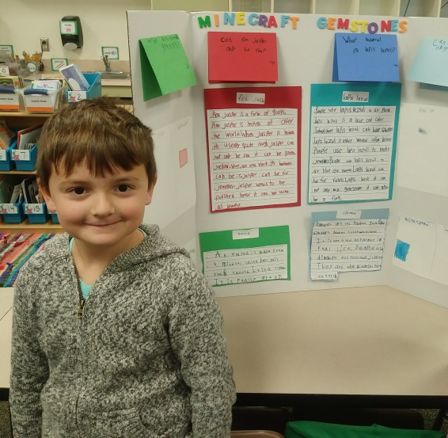
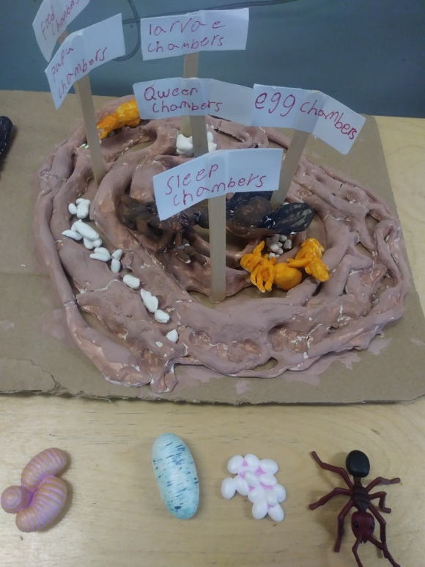
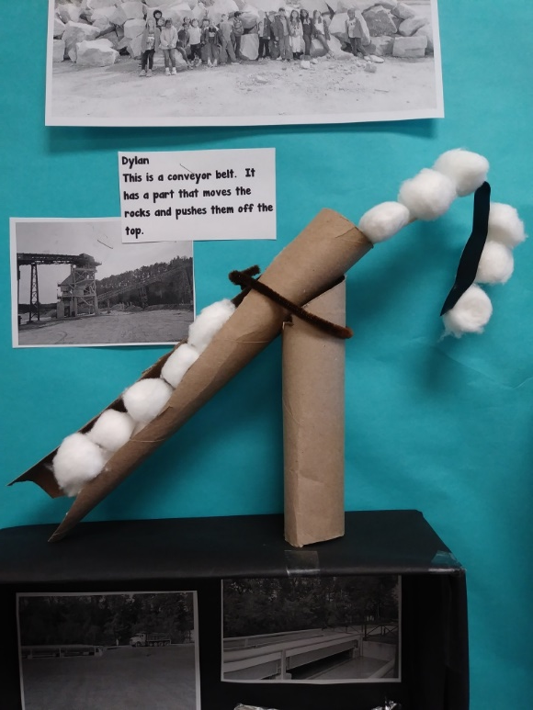
Project Approach
Phase 3: Sharing what we learn with others
Use our research to create a final culminating project to present to one or more audiences

Slide 11
Project Approach
How can you help?
Useful junk
Model magic
Connect us with guest experts or field experiences
Our first project: Rocks!
Think about: types of rocks, how rocks are formed, fossils, volcanoes, gemstones, etc.
You only have to know more than a first grader knows!

Slide 12
Calm Corner
K-1 Initiative
Led by our guidance counselors
Calming Strategies
Used to enforce self-coping
Breathing techniques
Conscious Discipline
We use Conscious Discipline resources found at https://consciousdiscipline.com/free-resources/shubert/

Slide 13
Friday Journals
My favorite part of the week!
It is a tool to communicate with your child about what is happening at school
Please remember this is an unedited piece of writing and won’t be your child’s best work – please be supportive!
There are sentence starters on the bottom to help
Trust me – it is well worth it at the end of the school year when you get to see the growth your child has made!

Slide 14
Q & A
Questions?
Please feel free to email me any time at kmallard@wcpss.net
If you want a quicker response please send a DOJO message.

